Slide 1
Central Texas Section Progress report January 19th 2019

Slide 2
Event | Date | Amount of funding
IBM Internship Talk | Friday, January 25th 2019 | N/A
Java Oracle Certificate Tutorial workshops | Every other week starting from February 1st 2019 | $250
Arduino/Robotics Tutorial | Every other week starting from February 1st 2019 | $650
MCM/ICM Contest Preparation | Every other week starting from February 1st 2019 | $400
Recruitment and Media Management | Starting January 18th 2019 | $250
IEEExtreme Programming Preparation | Every other week starting from February 1st 2019 | $200

Slide 3
IBM Internship for Underrepresented Minorities Talk
Skype meeting with the director from IBM
Go over some key facts about the internship program
Encourage students to apply for the internship
Recruit more IEEE members
Potential sponsor

Slide 4
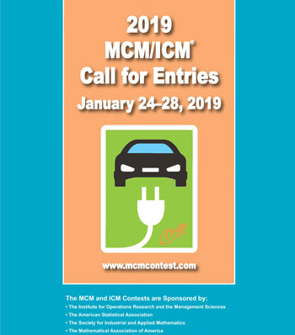
MCM/ICM Math modeling Competition Preparation
Date of competition: the end of January
Write a proposal to provide solutions to a prompt
Improve technical writing skills and research skills
Get familiar with advanced Math and scientific computation
Provide a stimulating learning environment
Venue: St Mary’s University

Slide 5
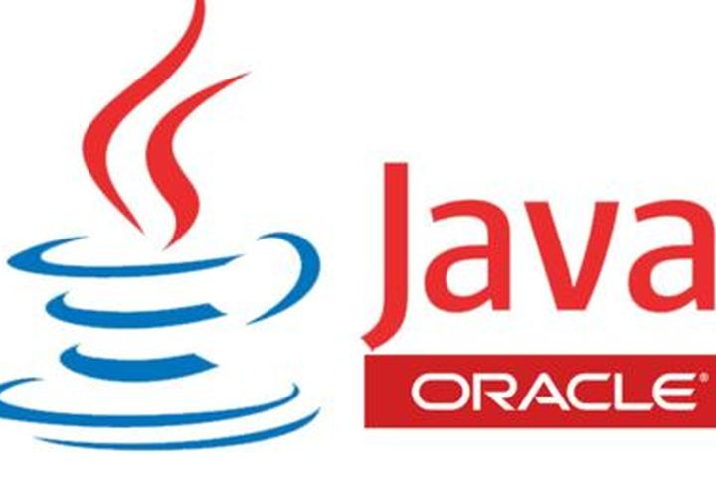
Java Oracle Certificate
Bi-weekly workshop to learn Java in Spring 2019
Get Java Oracle Certificate at the end
Introduce Object-Oriented Programming and good practice in coding
Put coding into practice and real-world applications
Venue: St Mary’s University

Slide 6
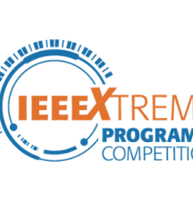
IEEExtreme Programming Competition Tutorial
A bi-weekly tutorial class to prepare students for next year IEEExtreme Programing Competition
Get familiar with optimizing code
Create a challenging playground to put coding skills into test

Slide 7
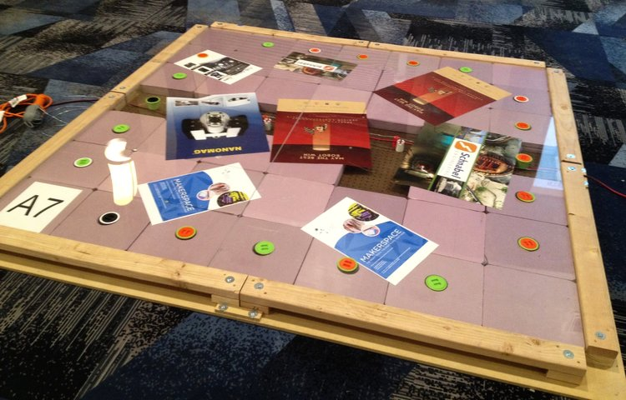
Arduino/Robotics Workshops
Bi-weekly tutorials on Arduino, Raspberry Pi
Help prepare for next year IEEE Robotics Competition
Mentor high school students for First Robotics Competition (FRC)
An opportunity to recruit high school students

